Slide 1
Q-The average delay between contamination discovery and official site case opening?

Slide 2
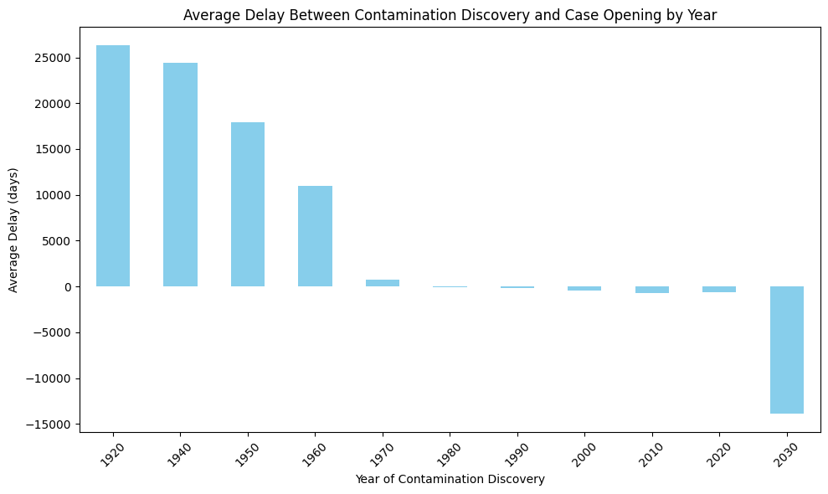
The bar chart shows the average number of days it takes for an official case to be opened after contamination is discovered, grouped by year of discovery.

Slide 3
Q-The trend of case closures (no_further_action_date) — a sign of regulatory progress

Slide 4
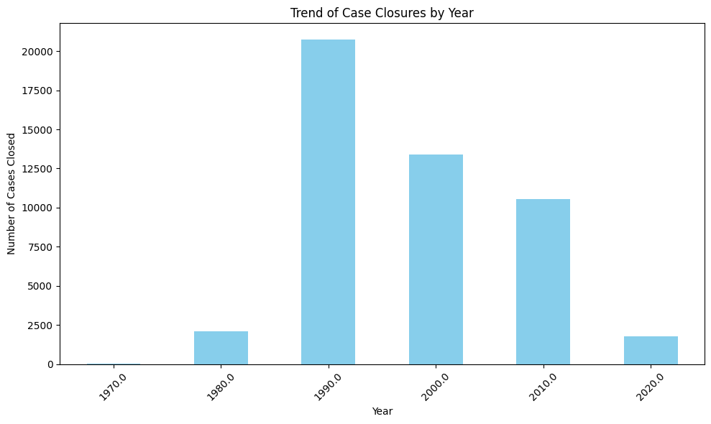
The bar chart reveals a steady increase in the number of cases reaching a "no further action" status over the last five years.

